Slide 1
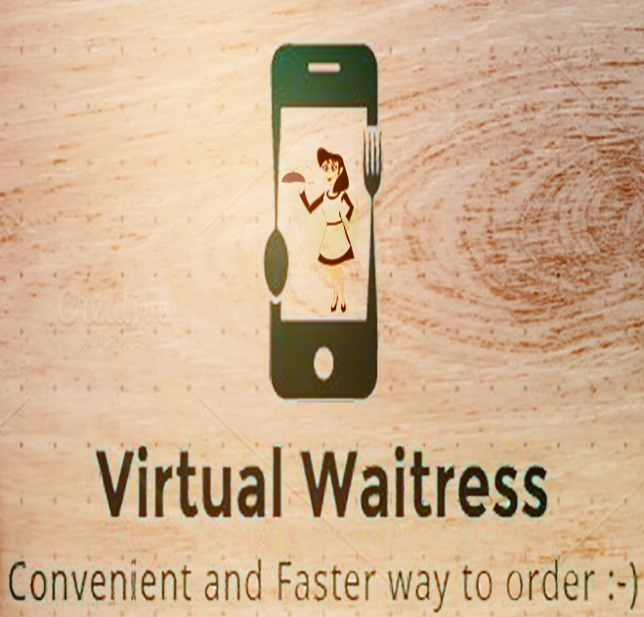
“Android Food Ordering System” (Virtual Waitress)
Students of G.V Acharya Polytechnic
Team Members:
Vipul Patil
Jagrut Goenka
Abhishek Dhiman
Abhijit Bansode
Rahul Kubal

Slide 2
Contents
Idea
Introduction
Platform for the Project
Technologies used
User Interface for an application
Advantages
Disadvantages
Future Scope

Slide 3
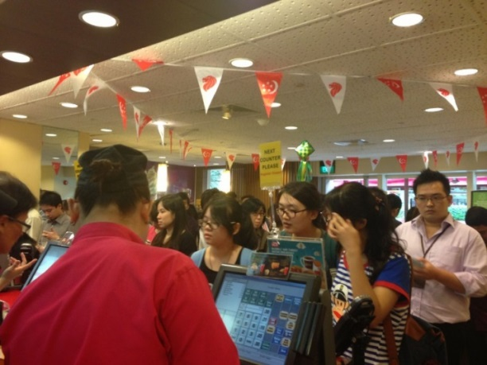
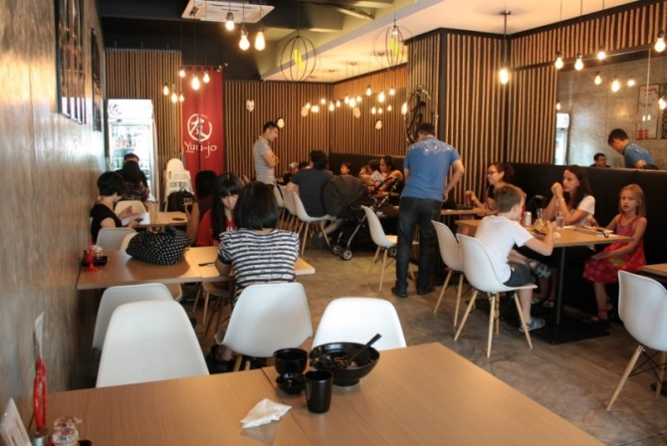
Idea
Problem definition:
At various restaurant & food chains the customer
satisfaction goes down due to following reasons.
Too much of waiting time for order.
Prolonged queues(In food chains).
Misplaced orders.
Uninformed lack of meals.
In short, improper management of the eateries.

Slide 4
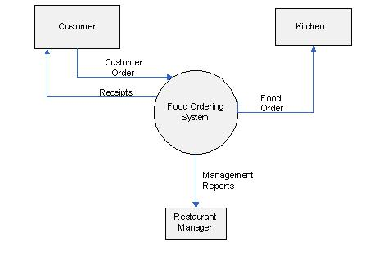
DFD diagram of Food Ordering System
Food ordering system plays the most crucial role in any restaurant or Food chain.

Slide 5
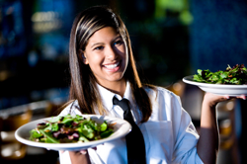
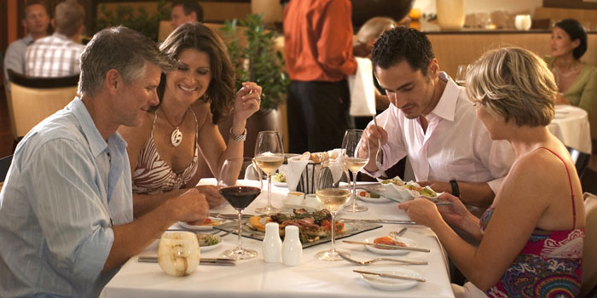
As per our observation
Customer satisfaction is directly proportional to the
management of the food ordering system of eateries.
Management of the Food Ordering system is inversely
proportional to the number of the customers.
Thus we are developing an application that will allow
the eateries to take orders and maintain records efficiently.

Slide 6
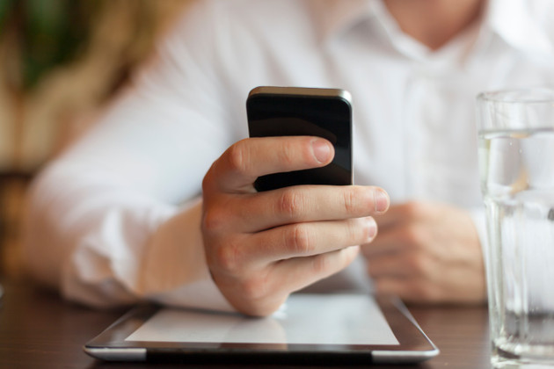
Introduction
Our app is aimed at providing the service to food chains and restaurants to take orders and maintain records more easily and efficiently.

Slide 7
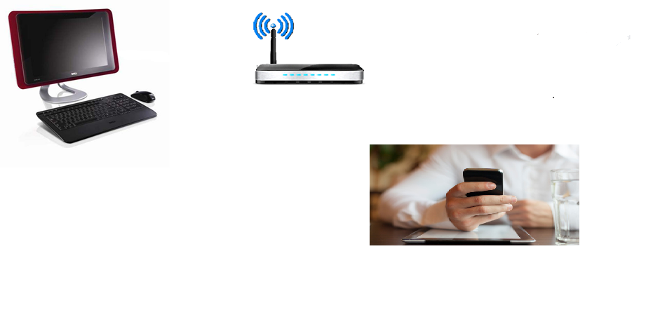
Graphical representation of the application

Slide 8
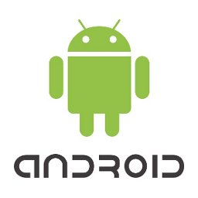
Platform for the Project
The platform for which the project has been implemented is for Android phones.
This same project can be further implemented for Windows Phone and IOS as well in later stage.
We chose android as the android studio , the IDE for developing android App is for free.

Slide 9

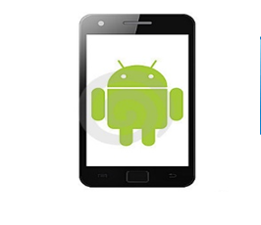


Requirements for Project
The Operating System for android phone is Android Ice Cream Sandwich or further for Customers.
The compatible Operating System for Windows PC is Windows 7 or further for Eatery.
The Eatery also requires a Wi-Fi router to establish a network connection between Eatery and Customer’s systems.

Slide 10
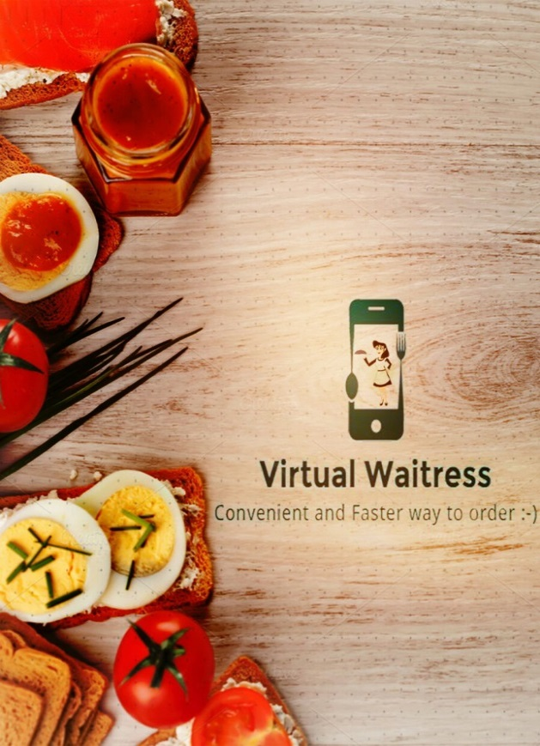
User Interface for our application
Splash screen

Slide 11
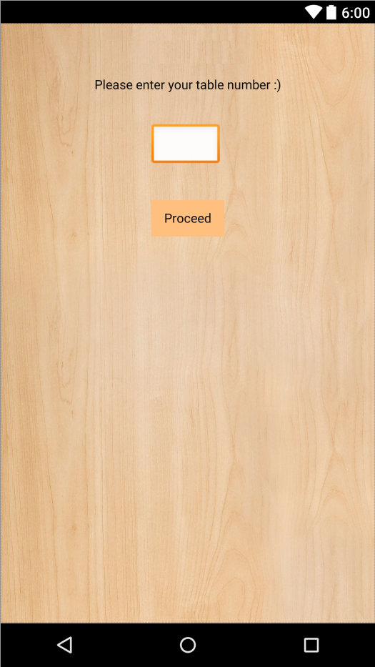
User Interface for our application
Registering Table number:

Slide 12
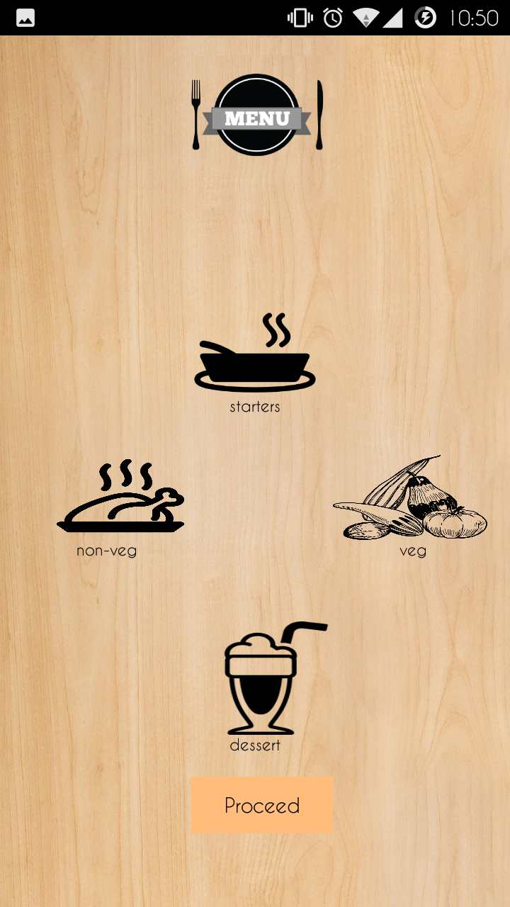
User Interface for our application
Select Category

Slide 13
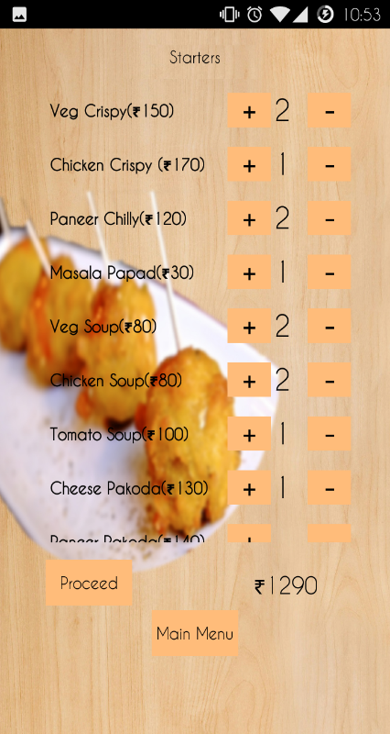
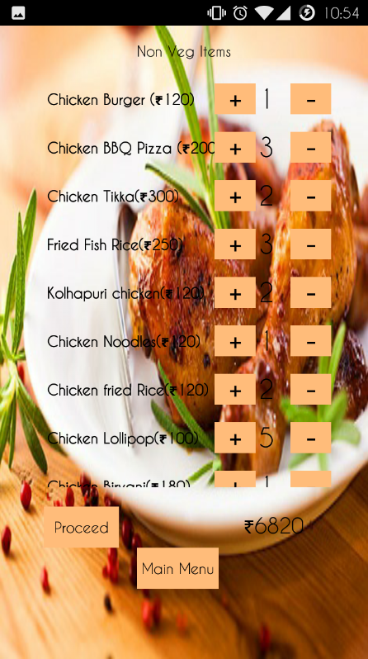
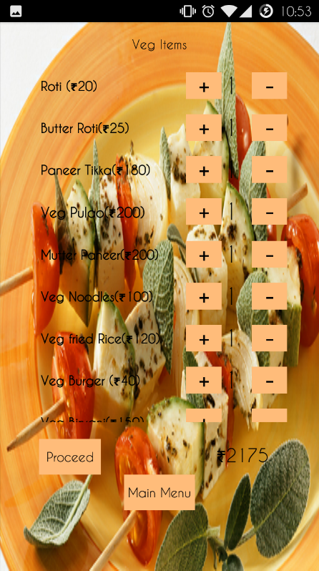
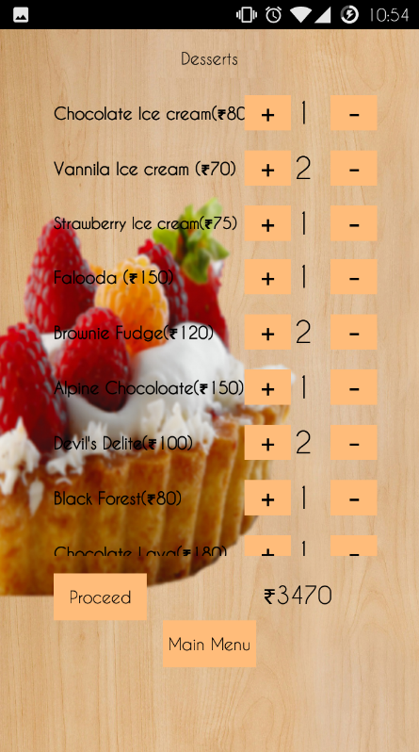
Order selection:
Starters
N-Veg
Veg
Dessert

Slide 14
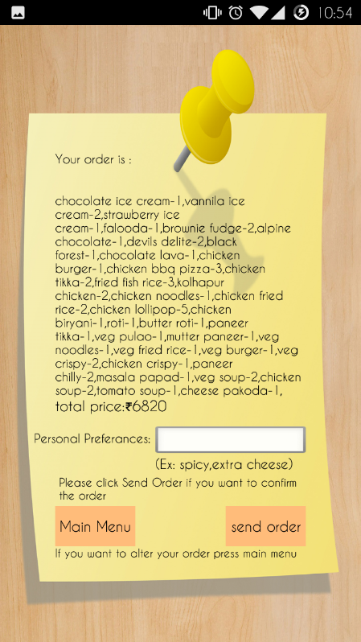
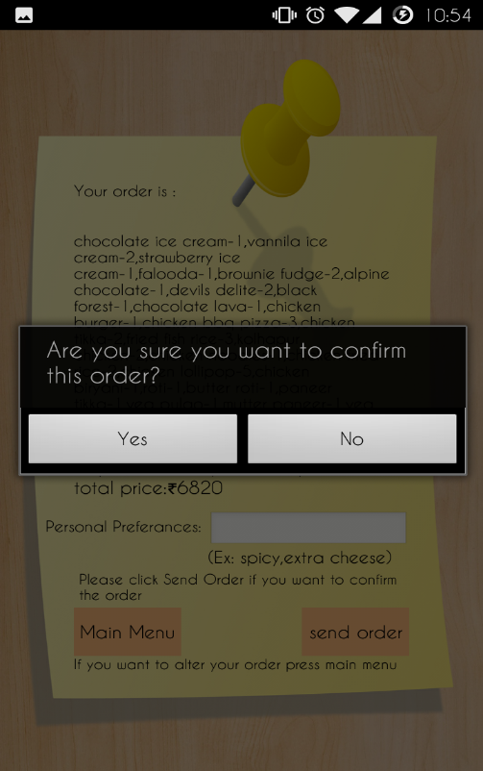
Bill & confirmation

Slide 15
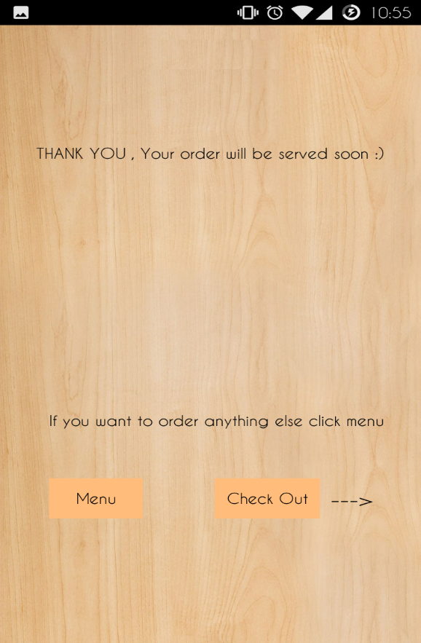
Confirmation:

Slide 16
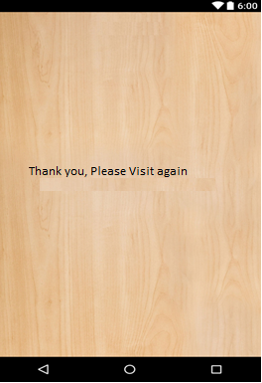
End Screen

Slide 17
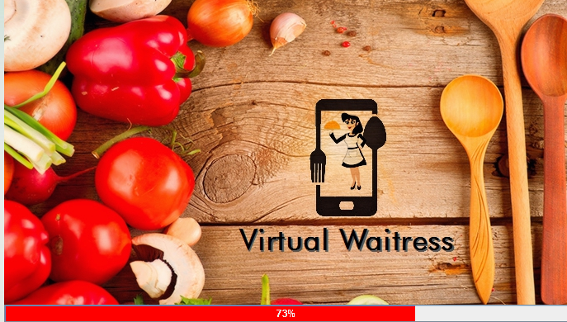
At the server’s side

Slide 18
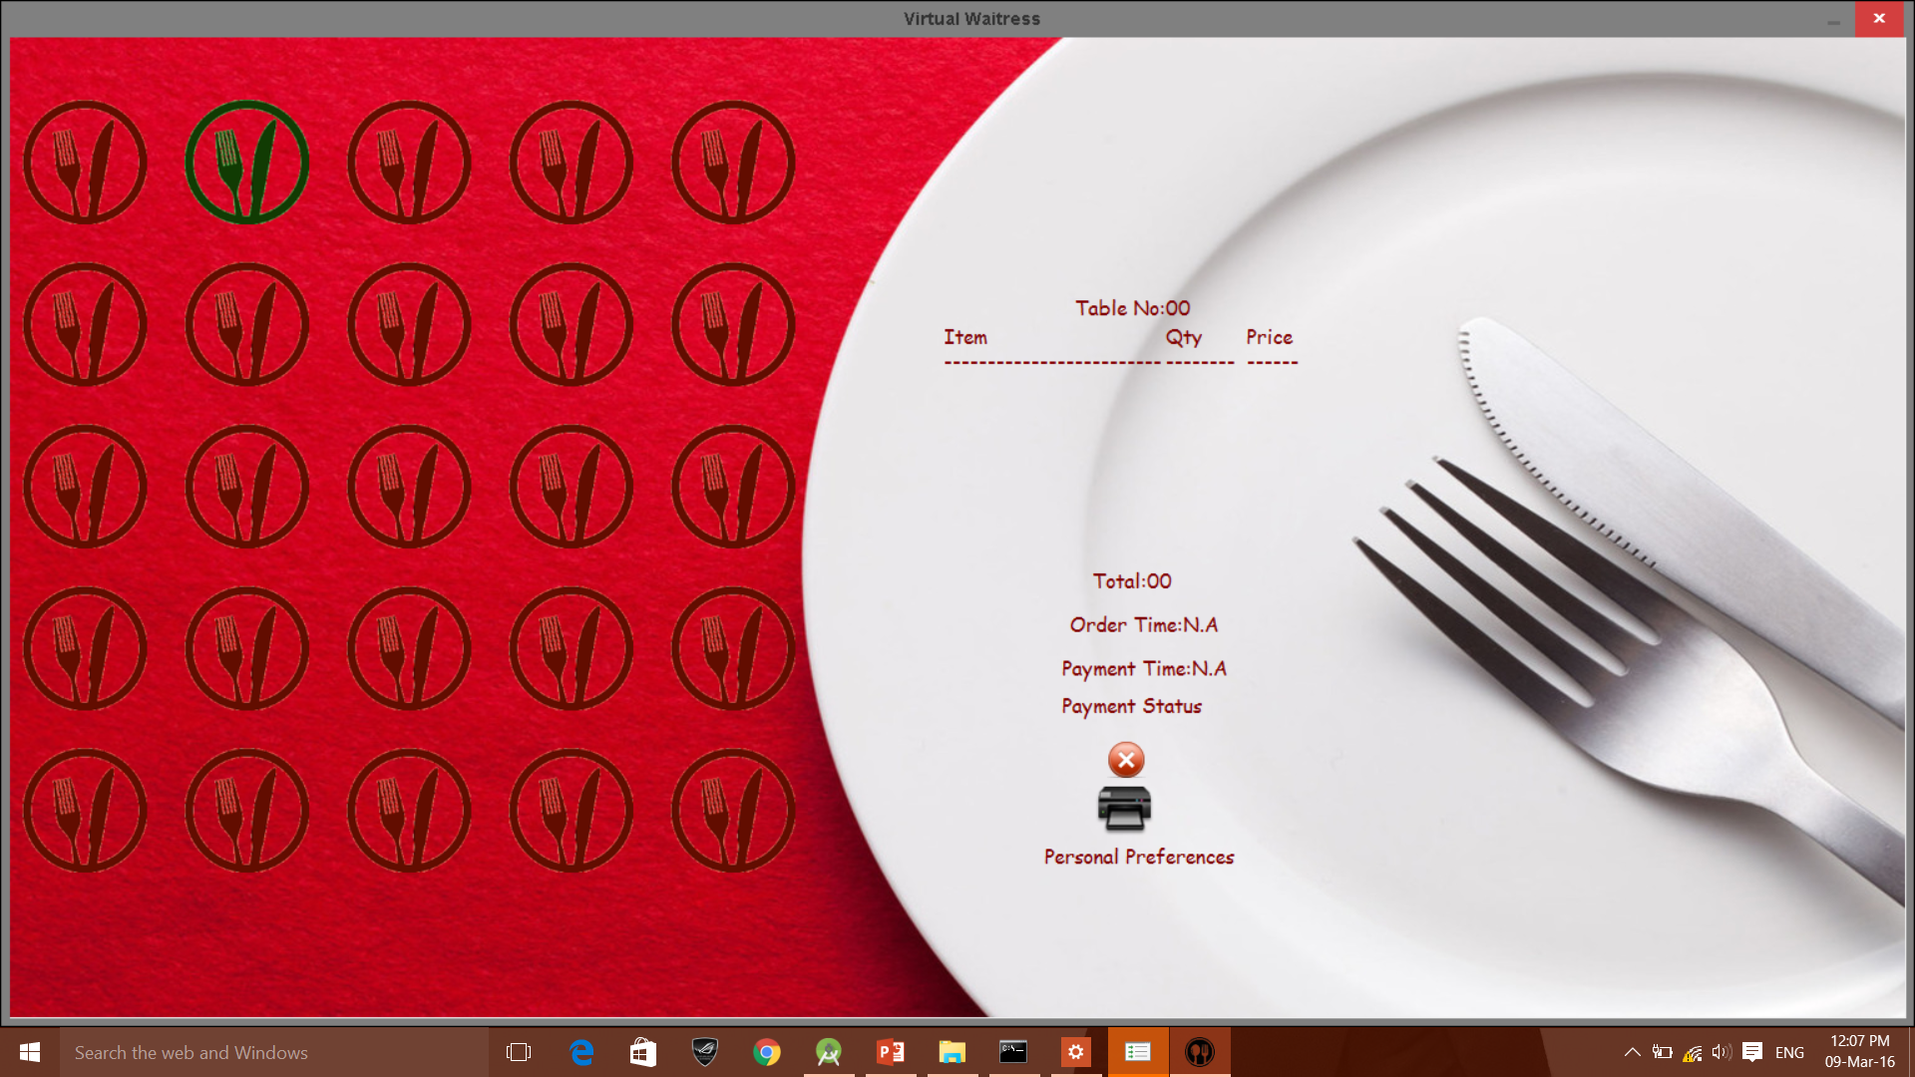
At the server’s side
Server side

Slide 19
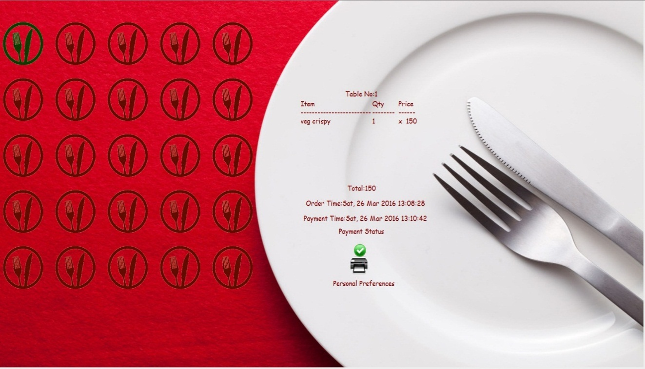
At the server’s side

Slide 20
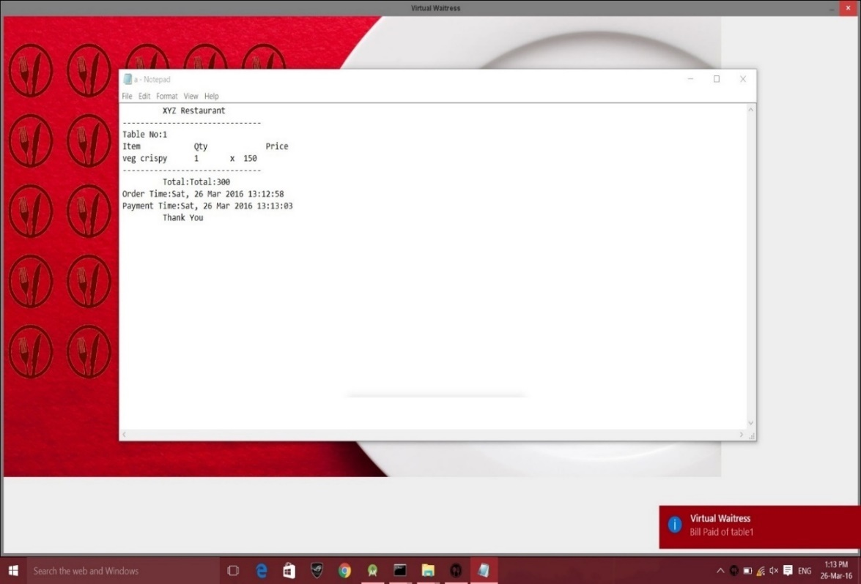
At the server’s side

Slide 21
At the server’s side

Slide 22
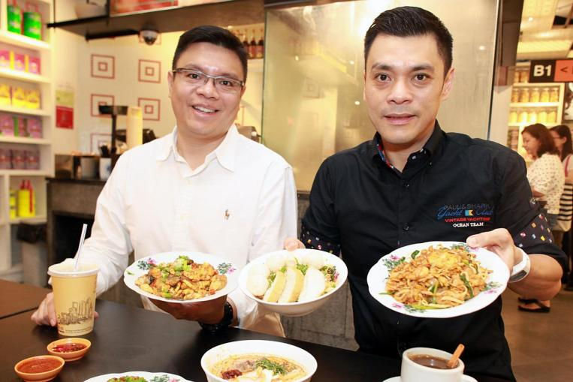
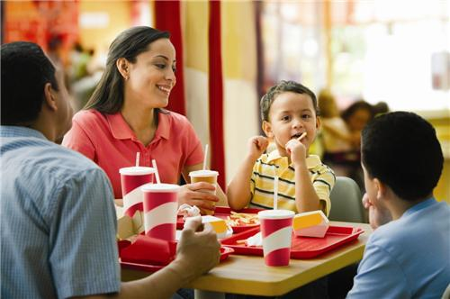
Advantages of project
Maintaining the record is more efficient.
Waiting in a queue has been avoided.
Manpower is reduced.
Waiting time for placing order decreases.
Proper selection of foodstuff and placement
of order

Slide 23
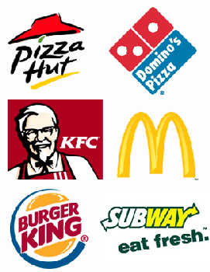

Disadvantages of project
It can only be used by a person with a proper knowledge
of using smartphone.
It may only be implemented at reputed
food chains like McDonalds, Dominos,
& restaurant etc.

Slide 24
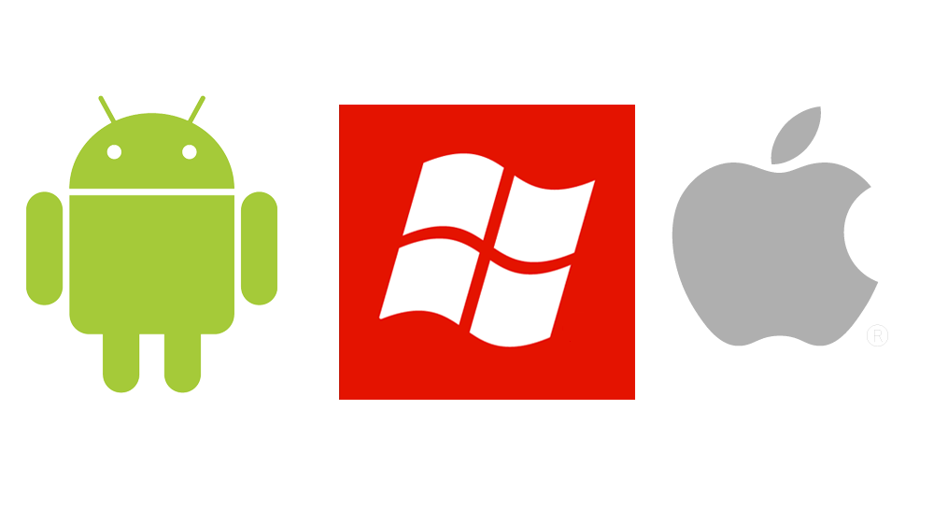
Future Scope
Currently the application is being developed for Android OS.
In future, the application can be developed for Windows smartphones and iOS as well.

Slide 25


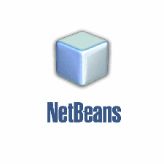
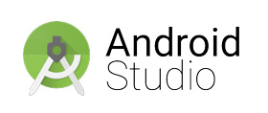
Technologies used
The IDE that has been used in developing this app are as follows:
Android Studio
NetBeans
The database used are as follows:
SQLite
JDBC
Languages used:
Java
SQLite(query language used)

Slide 26
References:
http://stackoverflow.com/
http://developer.android.com/
https://www.udacity.com/
https://www.thenewboston.com/

Slide 27
THANK YOU ☺

